Slide 1
Design Patterns and Refactoring
David Sackstein,
John Bryce Training

Slide 2
Agenda
SOLID Principles
Selected Design Patterns
Clean Code
Refactoring and Tests

Slide 3
The SOLID Principles
The Single Responsibility Principle
The Open Closed Principle
The Liskov Substitution Principle
The Interface Segregation Principle
The Dependency Inversion Principle

Slide 4
The Single Responsibility Principle
Classes and methods should have only one responsibility.
Classes and methods should have only one reason to change.
One file should contain only one class
SRP classes and methods are easier to understand and test.
Try to state the responsibility without using the word “and”.

Slide 5
The Single Responsibility Principle
A good indication of SRP violations is a lack of cohesiveness.
A cohesive class is one in which most fields are used referenced by most methods.
An islands of associated fields and methods should really be a class in itself.

Slide 6
The Open Closed Principle
A design should be open for extension and closed for modification.
That is, adding new functionality should not require changing existing functionality.
Do not add empty interface methods that are not required today.
Instead, use abstractions to simplify.

Slide 7
The Liskov Substitution Principle
Derived types must be substitutable for base types
It is not enough to find coincidental equivalence of public method signatures
Because the way they are expected to be used may differ
It is not enough to find common implementation methods.
Common implementations can be written in a third implementation class which is then used privately in both classes.

Slide 8
The Interface Segregation Principle
Clients should not be forced to depend upon interfaces that they don't use.
If you do, you make it easier for them to use the interface incorrectly.
If you do, you force them to learn more than they need to get a job done
The interfaces you design should reflect how your objects will be used rather than show off how many things they can do.

Slide 9
The Interface Segregation Principle
Organize methods of a large interface into groups that are used by similar clients.
Convert each group into a new interface.

Slide 10
The Dependency Inversion Principle
Program to interfaces and abstractions rather than to concrete types.
Situation:
Class A calls class B to get a job done.
Class B needs class C as part of its implementation
Do not: Have class B invoke the new operator to create object C.
Instead: Have B accept the interface of C in its constructor.

Slide 11
The Dependency Inversion Principle
The first approach creates a one directional dependency path A -> B -> C
The preferred approach inverts the dependencies in the following sense: B -> IC, C -> IC.
In the preferred approach A has control over the implementation used by B
Moreover, B is now testable by substituting a mock implementation of IC.

Slide 12
Design Patterns
Strategy
Factory Method, Abstract Factory
Dependency Injection (and IOC containers)
Decorator (Prefer Composition Over Inheritance)
Visitor

Slide 13
Strategy – The Problem
You are maintaining software that manages the finances of a company
The company is forced to cut expenses and you are required to make changes to the salaries of all employees.
As the company’s business may pick up in the future, you are required to enable reverting to the current calculations in the future.
What should you do?

Slide 14
Strategy – The Solution
Identify all variables that depend on the salary policy.
Encapsulate them in a class and change the code to use the class.
Find the minimum set of public methods required of the class and extract these as an interface.
Change the code so that it uses the interface rather than the class.
Implement the new salary policy as a second implementation of the interface.

Slide 15
Strategy – Benefits
The new policy and the old can be interchanged without changing the code that uses them.
New policies can be implemented and used without changes to the code that uses them.
The existing code and the salary policy can be tested separately.
These benefits show that Strategy implements the Open Closed Principle.

Slide 16
Factory Method - Problem
But who instantiates the salary calculation strategy?
If the answer is the code that uses it, then it remains dependent on a particular instance of the strategy.
The solution is to inject the strategy interface into a class that uses it by providing it as an argument to the class constructor.
But this is not always possible

Slide 17
Factory Method - Problem
If the strategy is not available before the class that uses it is created, it cannot be provided in the constructor of that class.
If the class that uses the strategy needs more than one instance, and especially if the number of instances it needs is not known when the class is created, injection of the strategy is not practical.

Slide 18
Factory Method - Solution
Create an interface containing a method that creates an instance of the strategy interface.
Create an instance of the interface for each concrete type of the strategy.
Provide an instance of the interface as a parameter of the using classes constructor.
The class can create as many instances as it needs of the strategy interface.

Slide 19
Factory Method - Benefits
The class gains control of when and how many instances of the strategy are created.
The class has no control (indeed no knowledge) of the concrete type of the strategy.

Slide 20
Abstract Factory
Problem: Independent factories may create non-compatible types of objects.
Solution: Define a factory for a family of objects that ensures that all instances that are created are compatible.
Benefits: Preserves the ability to create compatible objects without:
Needing to know their concrete type
Without the need for run time exception handling

Slide 21
Dependency Injection
Problem: Taken to its natural conclusion, the dependencies of all low level classes need to be instantiated in main() and passed down through every containing class.
This violates encapsulation and forces all levels of the code to know what lower levels need.
We would like the top level to know, but none of the middle levels.

Slide 22
Dependency Injection
Solution: An Inversion of Control (IOC) Container.
Top level code registers types as implementations of interfaces.
All classes just declare the dependencies they need (for instance as a constructor argument)
Top level code requests that the IOC container provide and instance of a class and the IOC container supplies all the dependencies of all the classes needed for this.

Slide 23
Dependency Injection in .NET
Castle
Unity
MEF

Slide 24
Decorator – Introduction
What is the purpose of inheritance?
Code reuse?
Polymorphism?
Answer: Polymorphism
For Code Reuse, use composition
When used for code reuse inheritance increases dependencies
When uses for polymorphism, inheritance reduces dependencies.

Slide 25
Decorator – Problem
You have written code for a coffee machine in which “Coffee” and “Tea” have a “Prepare” method.
You wisely extract an interface “IBeverage” so that Prepare can be called polymorphically on both.
You are asked to implemented “Coffee with Milk” and decide to create a new class with that name that inherits Coffee.
You are then asked to add the “Milk” option to tea.

Slide 26
Decorator – Problem
You then create TeaWithMilk.
Then comes a requirement to add a new beverage “cocoa” and a requirement to add a sugar option for cocoa and coffee.
For each combination you create a class using inheritance for the required components.
This strategy limits code reuse and requires recompilation for every new combination of features.

Slide 27
Decorator – Solution
Coffee, Tea and Cocoa implement IBeverage
Define BeverageWithSugar, BeverageWithMilk. These are decorators.
The decorators also implement IBeverage and accept an IBeverage in their constructors. That IBeverage is what was previously the base class.
To implement Prepare, the decorators call the Prepare method of their “base” class and add their own decoration

Slide 28
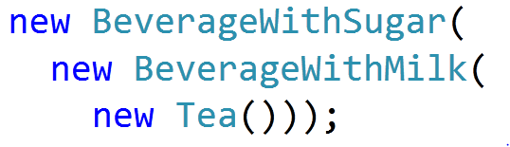
Decorator – Solution
All combinations of a base class and decorations can be combined dynamically without creating new types, so for instance, to create Tea with Milk and Sugar you would write:

Slide 29
Decorator – Benefits
New combinations of base classes and decorations can be composed without defining new classes
Each decoration can be reused
This is “dynamic inheritance”. Effectively, a type can change its base class at run time.

Slide 30
Visitor - Problem
You have defined an IEmployee interface with a Name property
A developer is an IEmployee with a YearsOfExperience property but no stock options
A manager is an IEmployee with a NumberOfOptions property.
A Company class has an Employees property which is a collection of IEmployees.

Slide 31
Visitor - Problem
You are asked to calculate the following:
1. The total number of options held by managers
2. The average years of Experience over all developers.
Here are two bad options
1. Iterate over each employee, check its concrete type.
2. Add NumberOfOptions & YearsOfExperience to IEmployee.
Both options violate the OCP
Why?

Slide 32
Visitor - Solution
Create a class for each task (counting options, averaging years of experience)
Each class implements an interface called IVisitor that offers a Visit method for each concrete employee type. The method accepts a reference to that type.
Add to IEmployee an Accept method that accepts a reference to an IVisitor.
The Accept method calls the Visit method of the visitor passing in the argument.

Slide 33
Visitor - Solution
The visitor that calculates the average years of experience of developers, for instance, will do the following:
In it’s Visit method that accepts a manager, it will do nothing.
In it’s Visit method that accepts a developer, it will accumulate the years of experience of the developer into it’s average field.

Slide 34
Visitor - Benefits
The OCP is not violated when new properties are added to implementations of IEmployee.
The OCP is not violated when new concrete implementations of IEmployee are added (though recompilation will be required)
The task performed by the visitor is encapsulated in a class.

Slide 35
Clean Code
Motivation
Code Smells
Refactoring Techniques
The Importance of Tests

Slide 36
Motivation
Clean code is readable.
This makes it easier to maintain, to extend and t o reuse.
The most practical way to write clean code is to refactor with every change.
Large redesigns later on will never keep up with the requirements.
You cannot really write “Quick and dirty” code. If its dirty, it will slow you down.

Slide 37
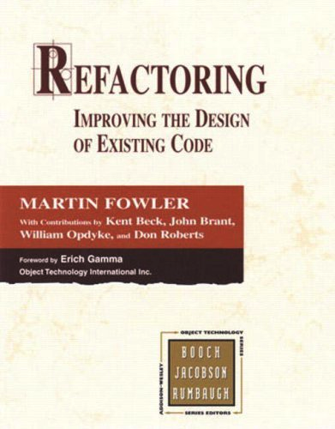
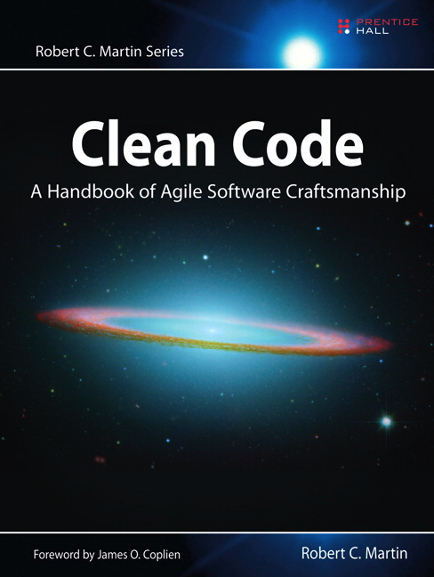
Recommended Reading

Slide 38
Code Smells
In his book, Martin Fowler defines “Code Smells” that indicate the need for refactoring
“Any symptom in the source code of a program that possibly indicates a deeper problem”
Examples
Comments
Code duplication
Long methods and large classes
Too many arguments
Switches and ifs

Slide 39
Comments
Bad Comments
Comments that are needed to explain what the code does, because the code is unclear.
Good comments
Clarify “why” not “what”
Explain “intent” that cannot be expressed in code

Slide 40
Code Duplication
“Every piece of knowledge must have a single, unambiguous, authoritative representation within a system” - The Pragmatic Programmer: Dave Thomas, Andy Hunt
Duplications bloat code making it difficult to read.
Duplications increase the chances of error when maintaining.

Slide 41
Long Methods
A method should have only one responsibility
If a method has more than 15 lines its probably too long.
A method should implement only one level of abstraction.
A method should have no more than one decision point (if-else, loops, switch)
A method should not “steal features” of the objects it uses.

Slide 42
Large Classes
A class should have only one responsibility
If a class has more than 15 methods its probably too large.
A class should implement only one level of abstraction.
Classes that are not cohesive should be split up.
If the class implements a concept that might be reused, that implementation should be in a separate class.

Slide 43
Too Many Arguments
No arguments - good
One argument - good
Two arguments – ok
Three arguments – bad: refactor
With three or more arguments developers will need documentation and to take great care in order to call the function with the right arguments and in the right order.

Slide 44
Switches and Ifs
Switches and ifs on enumeration values that appear more than once are potential violations of the OCP.
In particular, switches and ifs on a classes type need to be revisited if a new type is added.

Slide 45
Refactoring Techniques
How to eliminate code smells
Comments
Code duplication
Long methods
Large classes
Too many arguments
Switches and Ifs

Slide 46
Comments
Make the code legible by renaming methods, fields and variables using revealing names.
Extract Method
A block within curly braces {} is usually a candidate for a method.
The name of the new method is a concise version of the comment.
Remove the comment because its redundant.

Slide 47
Code Duplication
Use Extract Method on one occurrence of the duplicate code. Create Method1
Use Extract Method on another occurrence of the duplicate code. Create Method2
Compare Method1 and Method2 and verify that they are equal. (If not change them a little)
Remove one of the methods and have its callers call the other method instead.

Slide 48
Code Duplication
If the functionality of the duplicated code spans more than one function, use Extract Class.
The extracted methods will be methods of the extracted class.
Pull Up duplicate code into a common base class
Extract Class is more difficult to do than Pull Up but is preferable because:
It results in few dependencies.
Pull Up may violate the Liskov Substitution Principle.

Slide 49
Long Methods
Use Extract Method for code in curly braces
Use Extract Method for code that has a lower level of abstraction than the rest of the method.
Use Move Method when a method “steals features” from another object. Move the method to that object.

Slide 50
Too Many Arguments
Create a Parameter Object
This will force the method to steal properties and features of the Parameter Object.
Use Move Method to move those parts of the method to the Parameter Object.
Consider making the arguments fields of the class.

Slide 51
Consider this
You have a long method with a number of blocks.
Use Extract Method to for each block.
You will need to pass local variables as arguments to each method.
Make those arguments fields of the class.
You now have an “island”. The new fields are only used by the new methods you added.
Use Extract Class. The new class will contain the new methods and the new fields.

Slide 52
Switches and Ifs
Replace an enumerated value by a polymorphic type.
Rather than asking the value of the enumerated value and then branching on the result, call a method on the polymorphic type.
Comment implementations of these are the following Design Patterns: Factory, State, Strategy

Slide 53
Refactoring and Tests
Why and when should we refactor?
The importance of tests
Using Resharper to refactor safely

Slide 54
The importance of tests
Tests demonstrate code correctness.
But this is not the only objective.
Tests are a design tool that allows a developer to refactor code without breaking it.
Tests also encourage developers to design components that are “customer oriented”.
Tests document how the code should be used for other developers.

Slide 55
Tests Should Be
F – Fast
I – Independent
R – Repeatable
S – Self Validating
T - Timely

Slide 56
Tests and Refactoring Lab

